Slide 1

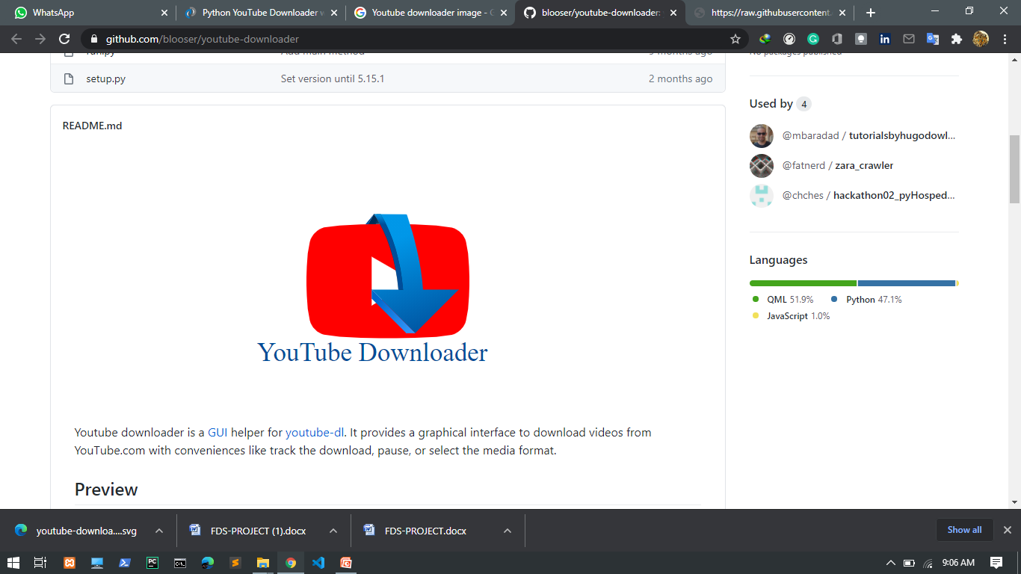
YouTube Video Downloader Application
Presented By:-
Mayank Kumar
(170280312)
Akshat Srivastava (99170280151)
Python Based Project – 100% Python Used

Slide 2
INTRODUCTION
Python GUI Project YouTube Video Downloader Application. Youtube downloader is a GUI helper for Pytube. It provides a graphical interface to download videos & Playlist from youtube.com. Youtube downloader’s goal is user has to copy the youtube video and playlist URL that they want to download and simply paste that URL in the ‘paste link here’ section and click on the download button, it will start downloading the video. When video downloading finishes, it shows a message ‘downloaded’ popup on the window below the download button.

Slide 3
DEPENDENCIES
Import os
Import Pytube
Import Pillow
Import tkinter
From tkinter.filedialog, messagebox
Import askdirectory

Slide 4
IMPORTANT REQUIRED MODULE
Os :- Utility module for OS interaction in programs The OS module in Python provides functions for creating and removing a directory (folder), fetching its contents, changing and identifying the current directory, etc.
Pytube :- pytube is a lightweight, Pythonic, dependency-free, library (and command-line utility) for downloading YouTube Videos.
Tkinter :- Tkinter is the standard GUI library for Python. Python when combined with Tkinter provides a fast and easy way to create GUI applications. Tkinter provides a powerful object-oriented interface to the Tk GUI toolkit.

Slide 5
Filedialog :- The tkinter.filedialog module provides classes and factory functions for creating file/directory selection windows.
Easygui :- This library is uesd for folder selection.
Pillow :- The Python Imaging Library adds image processing capabilities to your Python interpreter.This library provides extensive file format support, an efficient internal representation, and fairly powerful image processing capabilities.
Imageio :- Used to read the file which is chosen by file box using a path.
Messagebox :- The tkMessageBox module is used to display message boxes in your applications. This module provides a number of functions that you can use to display an appropriate message.

Slide 6
SCOPE
This can be used anywhere for YouTube video & playlist Download as well as in corporate world.
Right now not show the download status but in future update this application and add some new feature
This is used to download video and playlist that make up a path to a particular location.

Slide 7
REQUIREMENT
SOFTWARE REQUIREMENT
Operating System
Windows XP , Windows7, 8 & 10 etc.
Code editor
Visual Studio code & PyCharm.
Language
Python.
Framework
Python Tkiner.
HARDWARE REQUIREMENT
Processor
Pentium 2.0 and above.
Ram
Minimum 2 Gb .
Hard Disk
250 Gb.
.

Slide 8
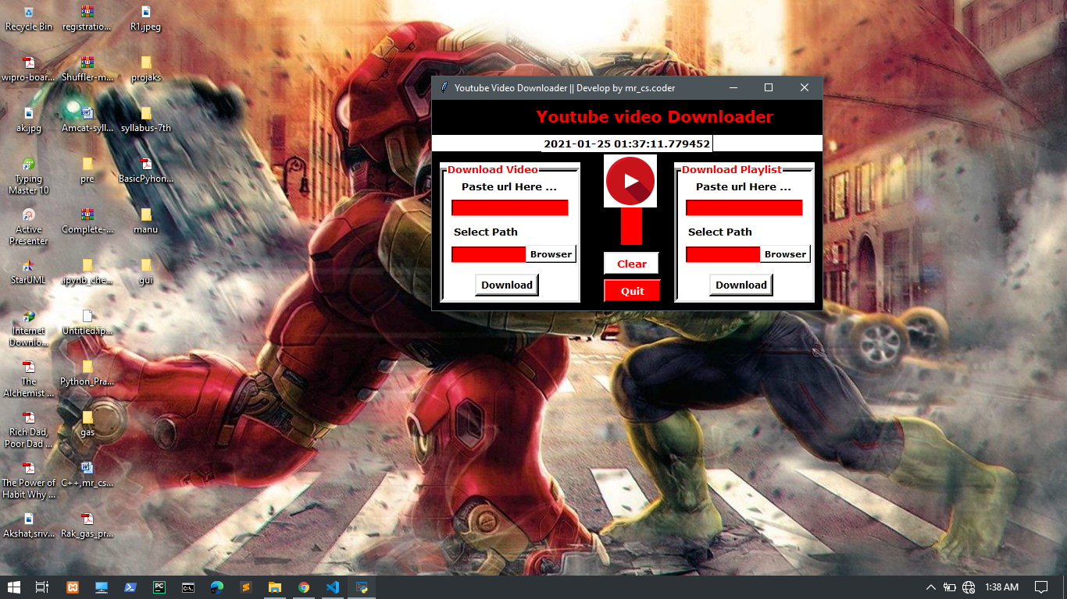
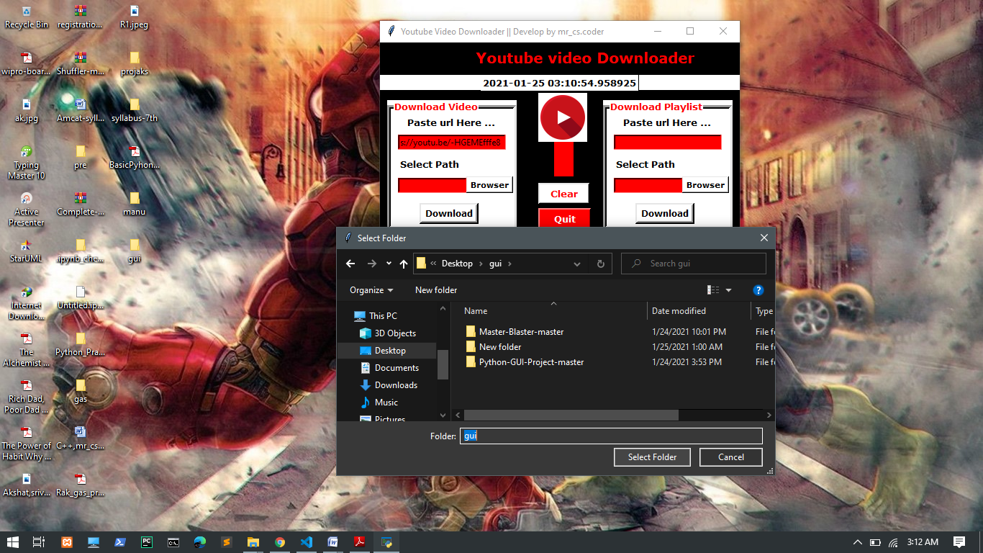
Number of unsorted file Paste Video / Playlist Url And
Sellect Download Location

Slide 9
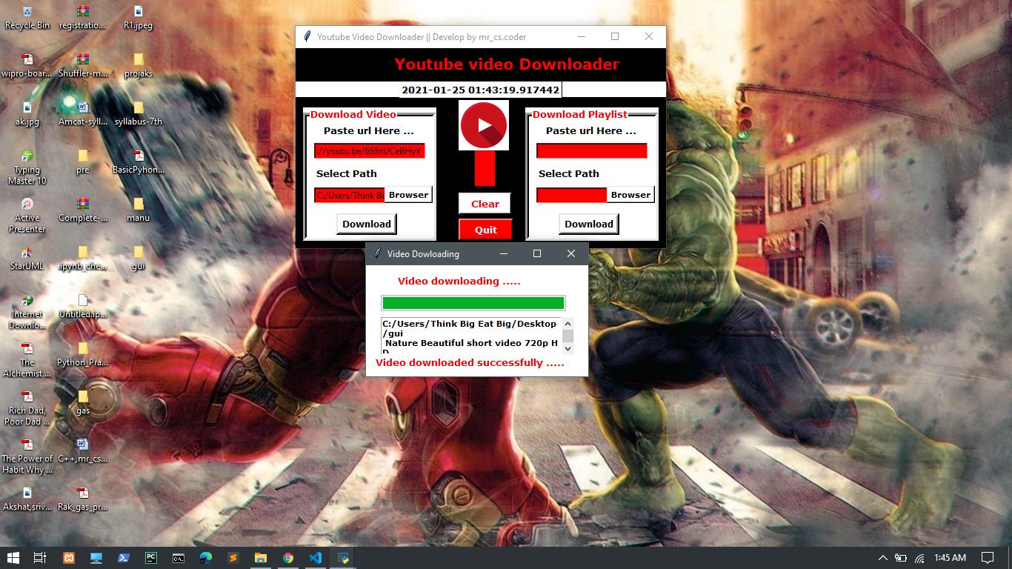
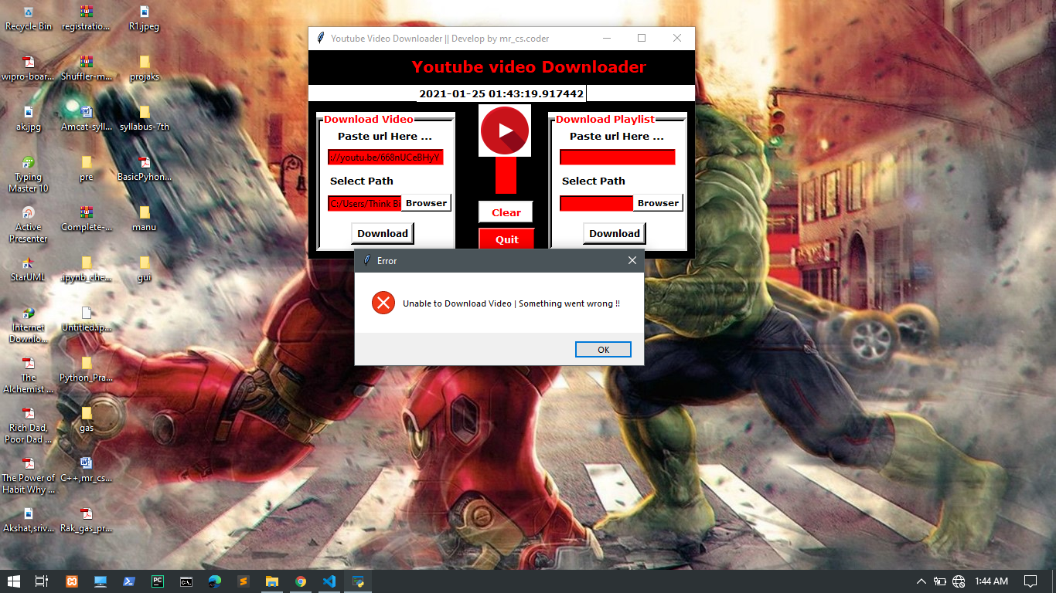
SCREENSHOTS
Download completed Something wrong messasge

Slide 10
FEATURES
Easy to use not so complex GUI interface.
Easy to separate all file.
User friendly.
This application is secure because this application work offline own your system and not share your information.
This application is save your lot of time youtube video & playlist download.
It is use in both places professional and non-professional.

Slide 11
REFERENCE
website
www.python.org
www.geeksforgeeks.org
Youtubes
Book
Python Crash Course: A Hands-On, Project-Based Introduction to Programming, Book by Eric Matthes.

Slide 12
CONCLUSION
Python GUI Project YouTube Video Downloader Application. Youtube downloader is a GUI helper for PYtube. It provides a graphical interface to download videos & Playlist from youtube.com. We used the popular Tkinter library that used for rendering graphics. We use the pytube library to download videos from youtube.The object of this project is to download any type of video in a fast and easy way from youtube in your device.In this python project, user has to copy the youtube video URL that they want to download and simply paste that URL in the ‘paste link here’ section and click on the download button, it will start downloading the video. When video downloading finishes, it shows a message ‘downloaded’ popup on the window below the download button
THANK YOU

